Slide 1


YouTube Data Collection and Engagement Analysis
Welcome! This presentation explores how YouTube data can be leveraged to drive engagement and maximize the impact of your content. We'll analyze key factors that influence viewer engagement and uncover strategies to boost your channel's success.
by Praveen Yarramalla

Slide 2

Objective of the Analysis
1
Understanding Viewer Behavior
Uncovering the factors that motivate viewers to interact with your content. This includes likes, comments, shares, and even the duration they spend watching.
2
Optimizing Video Performance
Utilizing data to identify and implement effective strategies to enhance engagement across your video content.
3
Data-Driven Insights
Transforming raw data into actionable insights that guide content creation and marketing decisions.
4
Improved Content Strategy
Developing a strategic approach to content creation based on proven audience preferences and engagement patterns.

Slide 3
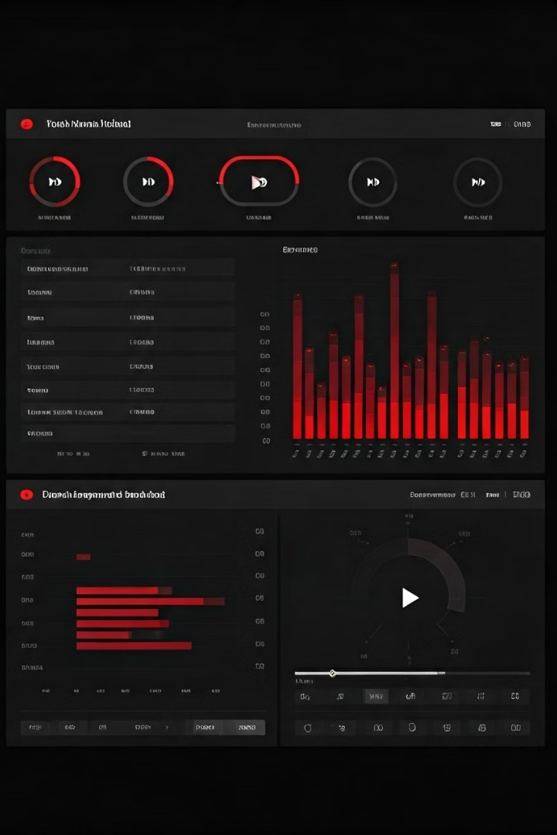
Data Collection Overview
Metric
Description
Video Views
Total number of times a video has been watched.
Likes
Number of positive reactions to a video.
Comments
Viewer interactions and feedback on a video.
Video Category
The genre or subject matter of the video (e.g., Music, Gaming, Education).
Video Length
Duration of the video in minutes.
Upload Time
Time of day when the video was uploaded.
Engagement Metrics
Measures of viewer interaction, including likes, comments, and watch time.

Slide 4
Key Insights for Maximizing Engagement
Interaction Encouragement
Video Length
Upload Time
Shorter videos, especially under 5 minutes, tend to result in higher engagement rates, particularly in categories like Music and Entertainment.
Uploading videos during peak hours, typically between 2 PM and 8 PM, generally leads to higher initial views and engagement.
Prompt viewers to like, comment, and share your videos. Encourage discussion by asking questions or posing engaging challenges.

Slide 5

Recommendations for Content Creators
1
Short and Sweet
Focus on creating concise and captivating content to maintain viewer attention, especially for shorter-form video platforms.
2
Category Focus
Prioritize high-engagement categories such as Music, Entertainment, and Gaming to maximize your chances of attracting a wider audience.
3
Strategic Uploads
Schedule uploads strategically during peak hours when viewers are most active, maximizing initial views and engagement.

Slide 6




Conclusion and Next Steps
Data-Driven Approach
Utilize data analysis to inform content creation and marketing strategies, leading to more engaging and successful content.
Testing and Iteration
Experiment with different content formats, video lengths, and upload times based on audience feedback and data analysis.
Continuous Improvement
Continuously monitor engagement metrics, adapt strategies, and refine your approach for ongoing success on YouTube.

